Slide 1
Digital Image processing 9
Dep. of Computer Science & Information Engineering, Asia University
Associate Professor
Rung-Sheng Chen

Slide 2
1. AI, ML, DL
2. Machine VS. Deep learning
3. Convolutional Neural Networks
3.1 Convolution Layer
3.2 Max Pooling Layer
3.3 RelU (Rectified Linear Unit) Activation Function
3.4 Fully Connected layers

Slide 3
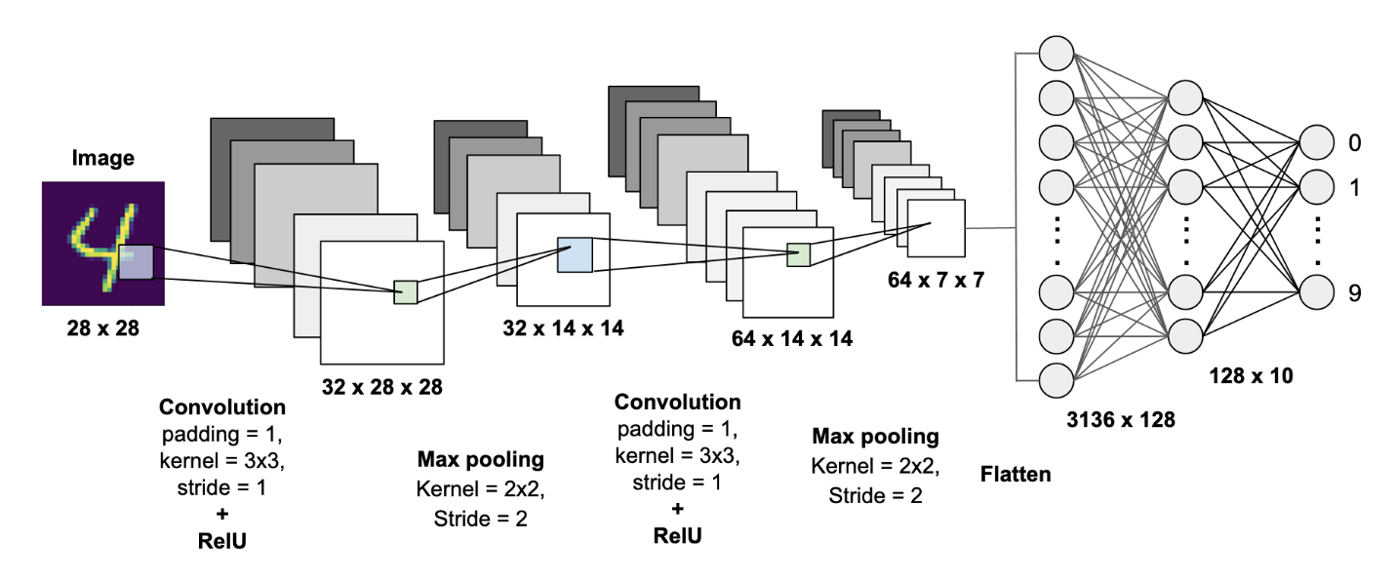

Slide 4
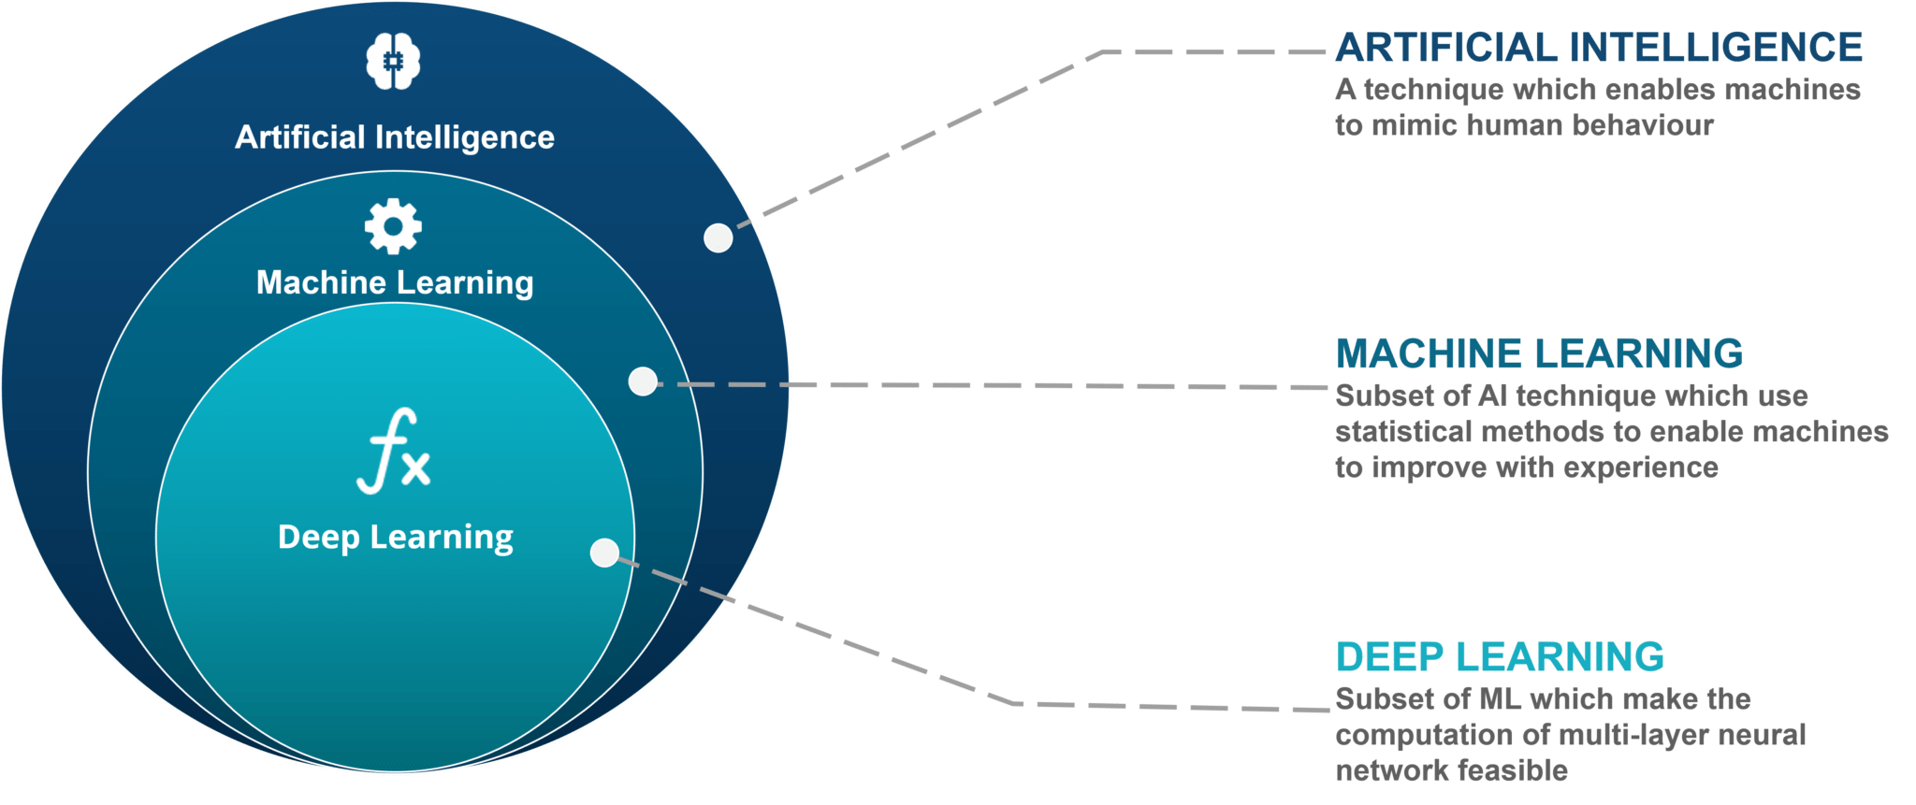
1. AI, ML, DL
AI: Artificial Intelligence
ML: Machine Learning
DL: Deep Learning

Slide 5
2.Machine VS. Deep learning[1]
To define deep learning and understand the difference between deep learning and other machine-learning approaches, first we need some idea of what machine learning algorithms do.
It can be stated that machine learning discovers rules to execute a data-processing task, given examples of what’s expected. So, to do machine learning,
we need three things:

Slide 6
So, to do machine learning, we need three things:
1. Input data points—For instance, if the task is speech recognition, these data points could be sound files of people speaking. If the task is image tagging, they could be pictures.
2. Examples of the expected output—In a speech-recognition task, these could be human-generated transcripts of sound files. In an image task, expected outputs could be tags such as “dog,” “cat,” and so on.
3. A way to measure whether the algorithm is doing a good job—This is necessary in order to determine the distance between the algorithm’s current output and its expected output. The measurement is used as a feedback signal to adjust the way the algorithm works. This adjustment step is what we call learning.

Slide 7
Deep learning is a specific subfield of machine learning: a new take on learning representations
from data that puts an emphasis on learning successive layers of increasingly meaningful representations. The deep in deep learning isn’t a reference to any kind of
deeper understanding achieved by the approach; rather, it stands for this idea of successive layers of representations.

Slide 8
3. Convolutional Neural Networks — A Beginner’s Guide[2]
3.1 Convolution Layer
Before digging into what a convolution layer is, let’s understand why use them in the first place.
3.1.1 Why use a Convolution Layer?
Before the concept of convolution was presented by Yann LeCun in 1998 [3]for digit classification, people used other methods like support vector machine, knn, logistic regression, etc to classify images. In those algorithms, pixel values were considered as features i.e. for a 28x28 image there would be 784 features.

Slide 9
There are a lot of algorithms that people used for image classification before convolution became popular. People used to create features from images and then feed those features into some classification algorithm like SVM[4].

Slide 10
Convolution layer uses information from adjacent pixels to down-sample the image into features by convolution and then use prediction layers to predict the target values.

Slide 11
3.1.2 How does a Convolution layer work?
One uses multiple convolution filters or kernels that run over the image and compute a dot product. Each filter extracts different features from the image.

Slide 12
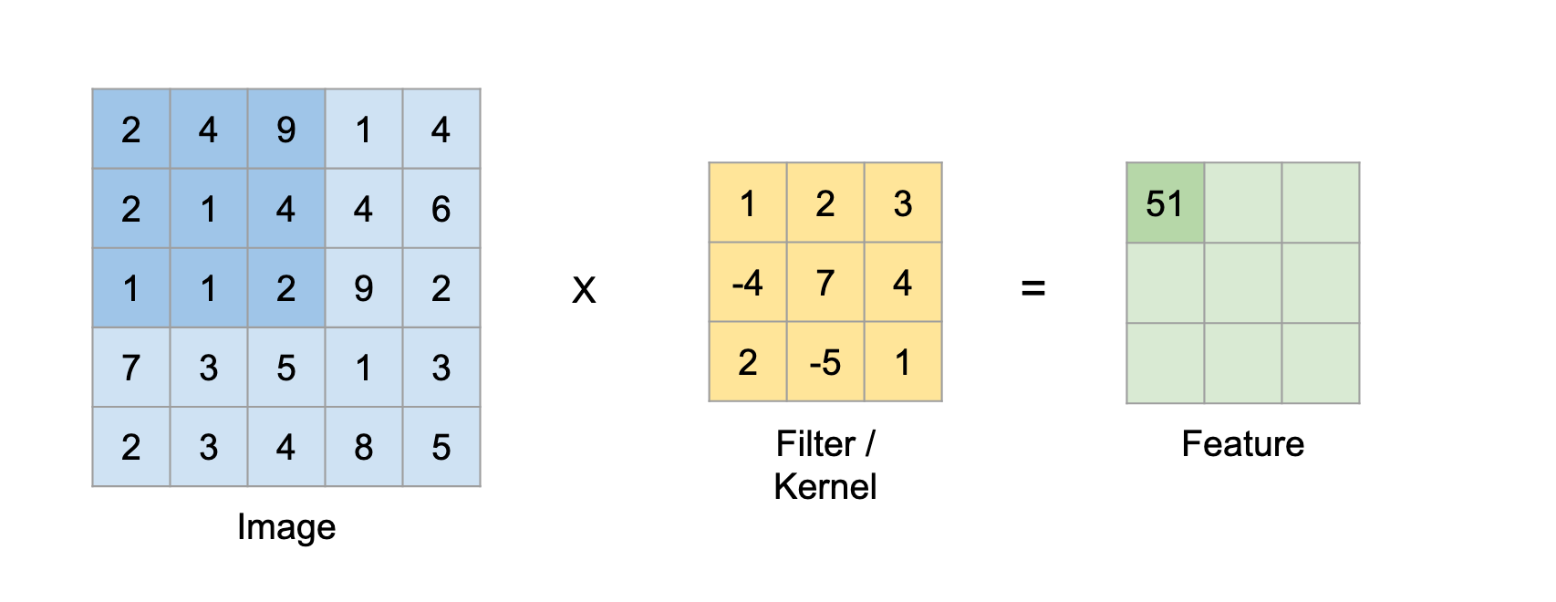
Lets consider a filter of size 3x3 and an image of size 5x5. We perform an element wise multiplication between the image pixel values that match the size of the kernel and the kernel itself and sum them up. This provides us a single value for the feature cell.
Fig.1 Convolution operation step — 1
2*1 + 4*2 + 9*3 + 2*(-4) + 1*7 + 4*4 + 1*2 + 1*(-5) + 2*1 = 51

Slide 13
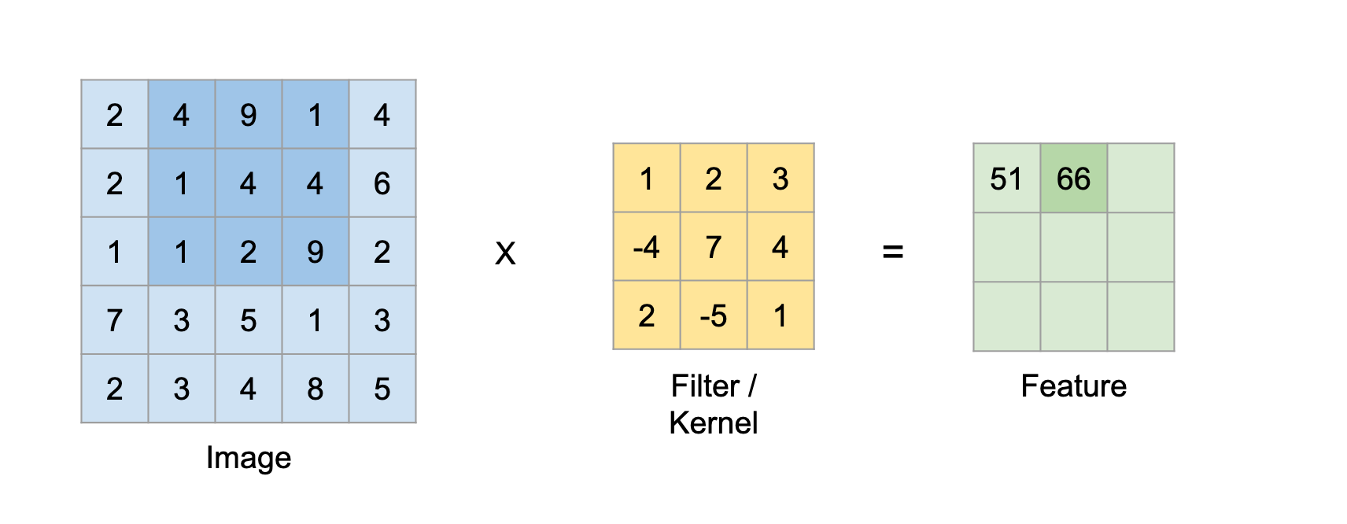
Filter continues to run further on the image and produce new values as shown right.
4*1 + 9*2 + 1*3 + 1*(-4) + 4*7 + 4*4 + 1*2 + 2*(-5) + 9*1 = 66
and so on …
Fig.2 Convolution operation step — 2

Slide 14
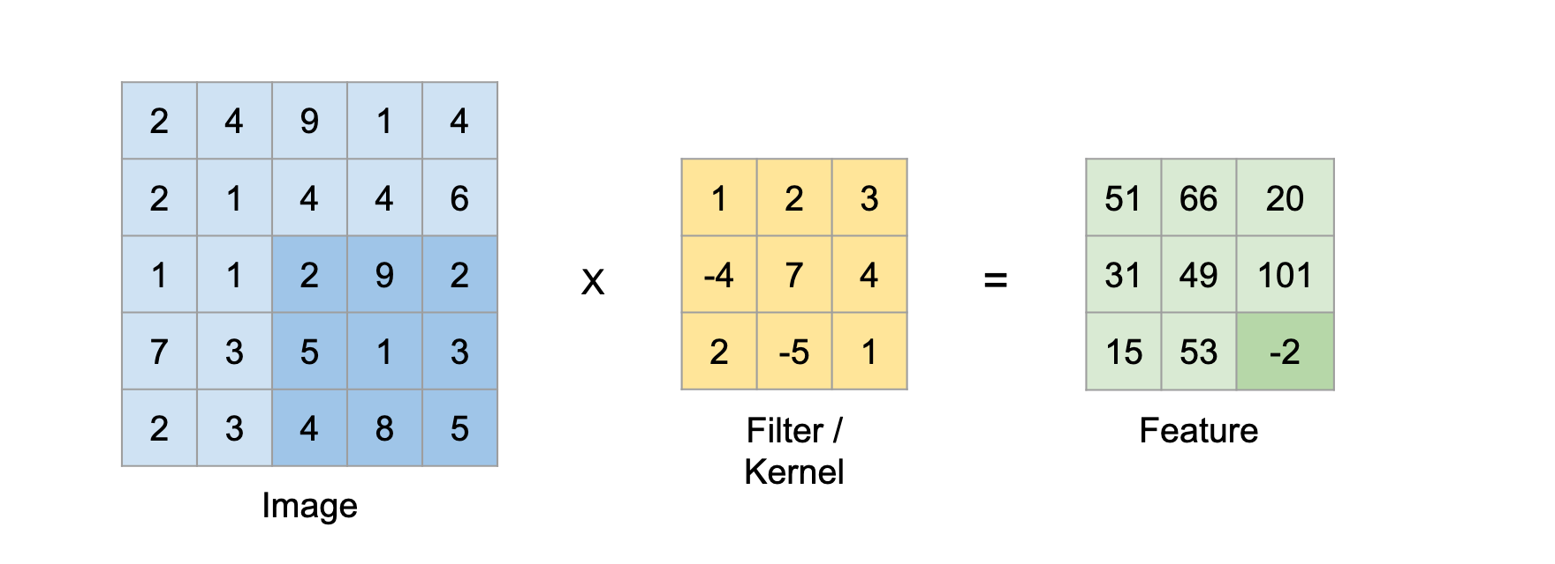
Fig.3 Convolution operation step — final
2*1 + 9*2 + 2*3 + 5*(-4) + 1*7 + 3*4 + 4*2 + 8*(-5) + 5*1 = -2
In the above example we are sliding the kernel by 1 pixel. This is called stride. We can have the kernel move by different stride values to extract different kinds of features.

Slide 15
Also the amount of stride we choose affects the size of the feature extracted. The equation to calculate the size of feature for a particular kernel size is as follows:
Feature size = ((Image size − Kernel size) / Stride) + 1
We can put the values for the above example and verify it.
Feature size = ((5 − 3) / 1) + 1 = 3

Slide 16
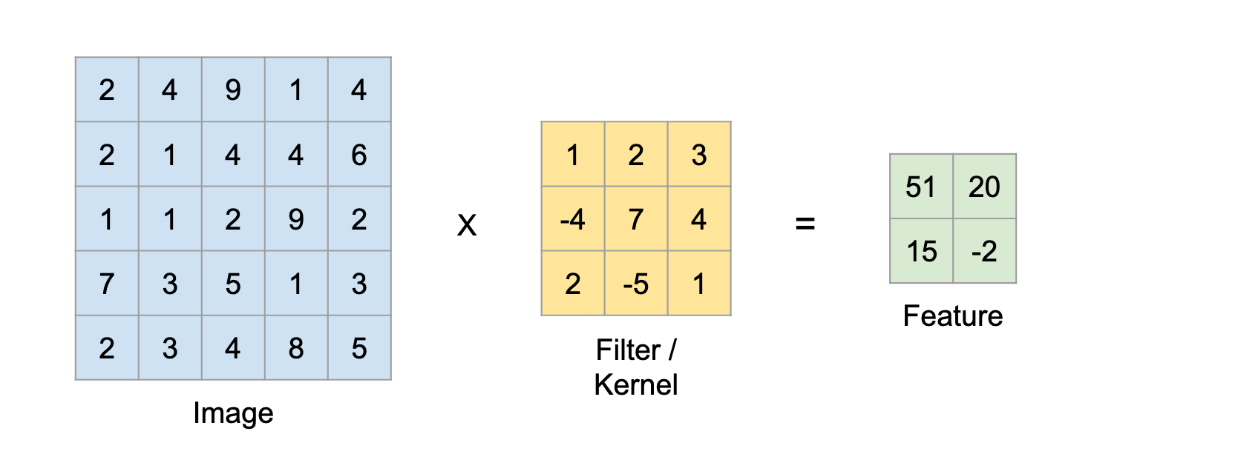
Fig.4 Convolution operation kernel size 3 and stride 2

Slide 17
3.1.3 What if you want the feature to be of the same size as the input image?
One can achieve this by padding the image. Padding is a technique to simply add zeros around the margin of the image to increase it’s dimension. Padding allows us to emphasize the border pixels and in order lose less information.

Slide 18
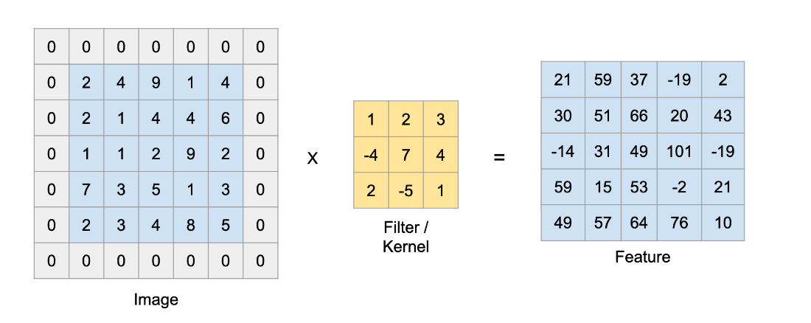
Here is an example with an input image of size 5x5 which is padded to 7x7 i.e. padding size of 1 and convoluted by a kernel of size 3x3 with stride of 1 resulting in a feature of size 5x5.
Fig. 4 Convolution operation kernel size 3, stride 1 and padding 1

Slide 19

The equation to calculate the size of feature for a particular kernel size when considering a padded image is as follows:
Feature size = ((Image size + 2 * Padding size − Kernel size) / Stride)+1
We can put in the values for the above example and verify it.
Feature size = ((5 + 2 * 1 − 3) / 1) + 1= 5
For an image with 3 channels i.e. rgb we perform the same operation on all the 3 channels.

Slide 20
A neural network learns those kernel values through back propogation to extract different features of the image. Typically in a convolutional neural network we would have more than 1 kernel at each layer.

Slide 21
28X28→32X28X28
Fig. 5 convolution layer
①Input : Scale of input image is 28X28
②Convolution layer :Kenel = 3X3 、Stride =1 、 Padding = 1
③ Input ： 28X28 （same size as input ）X32（because of 32 kenel）
④ReLu

Slide 22
3.2 Max Pooling Layer
Max pooling layer helps reduce the spatial size of the convolved features and also helps reduce over-fitting by providing an abstracted representation of them. It is a sample-based discretization process.
It is similar to the convolution layer but instead of taking a dot product between the input and the kernel we take the max of the region from the input overlapped by the kernel.

Slide 23
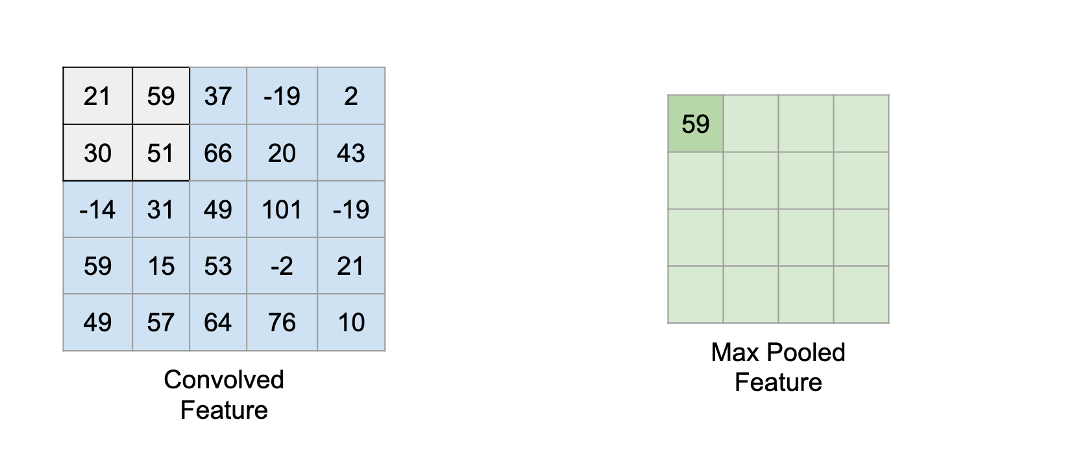
Below is an example which shows a maxpool layer’s operation with a kernel having size of 2 and stride of 1.
Fig. 6 max pooling 1

Slide 24
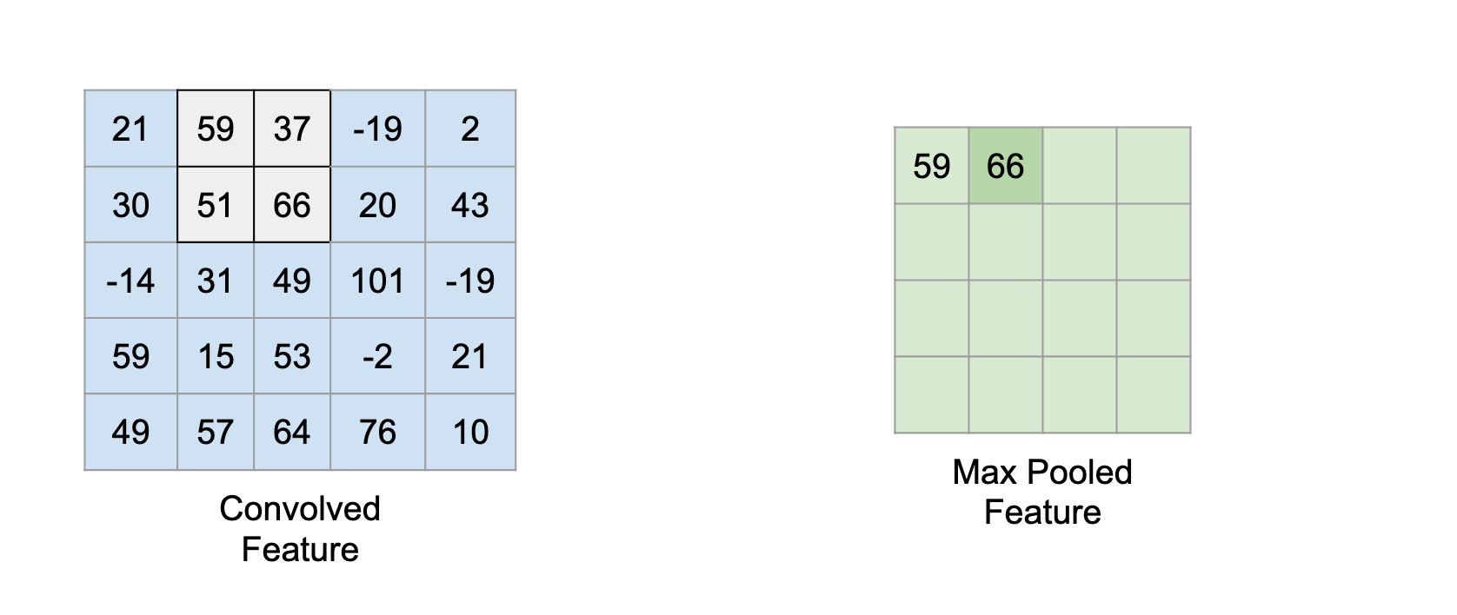
Fig.7 max pooling 2

Slide 25
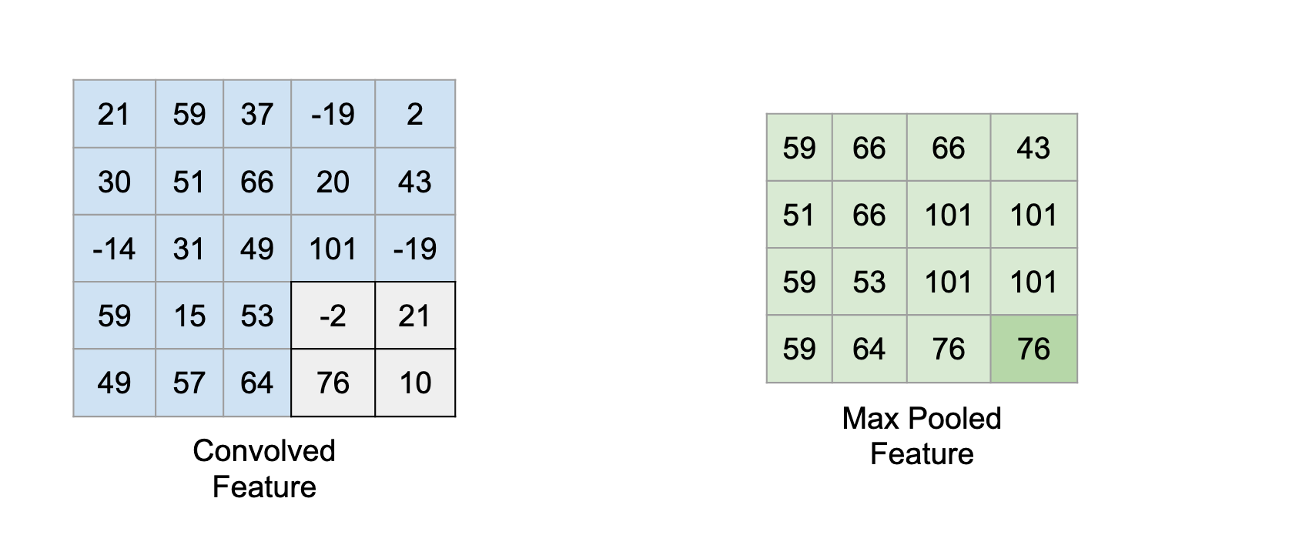
Fig.8 max pooling 3
kenel 2X2, Stride 1
stride 1: reduce 2/3
stride 2: reduce 1/2

Slide 26
32X28X28→32X14X14
kenel = 2X2
Stride = 2

Slide 27
3.3 RelU (Rectified Linear Unit) Activation Function
Activation functions introduce non-linearity to the model which allows it to learn complex functional mappings between the inputs and response variables. There are quite a few different activation functions like sigmoid, tanh, RelU, Leaky RelU, etc.

Slide 28
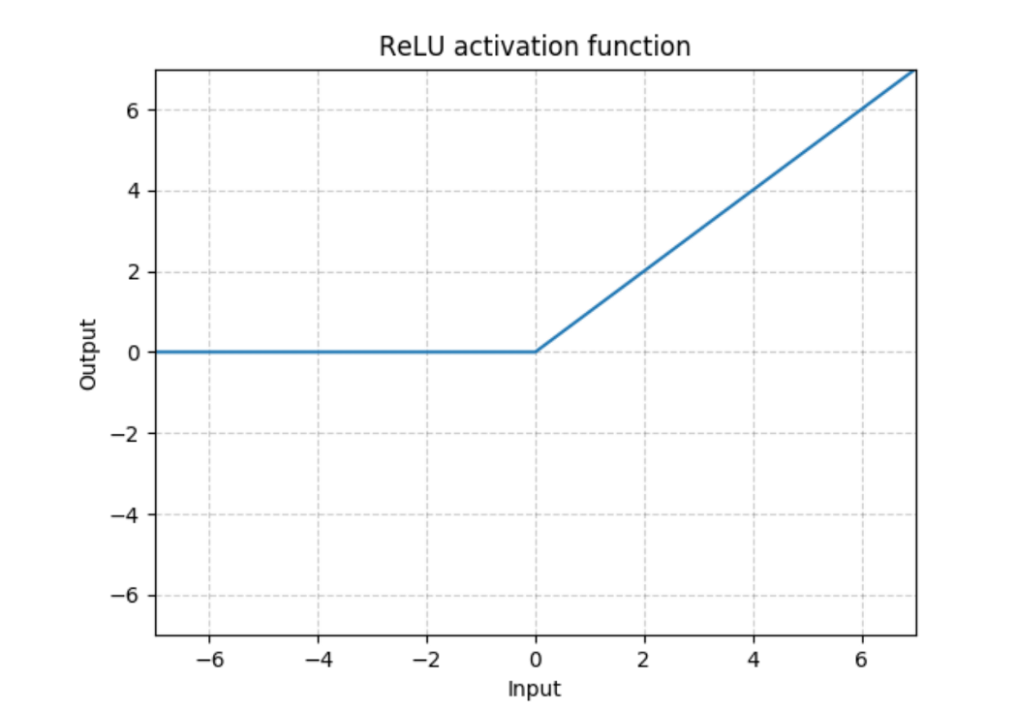
RelU function is a piecewise linear function that outputs the input directly if is positive i.e. > 0, otherwise, it will output zero.
ReLU(x)=max(0,x)

Slide 29
32X14X14→64X14X14→64X7X7
Convolution again with 64 kenel which is 2X2, then max pooling to half the scale asll

Slide 30
2D-1D
3.4 Fully Connected layers
28X28 = 784pixels were modified (or adjusted or featured or learned or Aied) to 3136 pixels, then to 128, then to 10

Slide 31
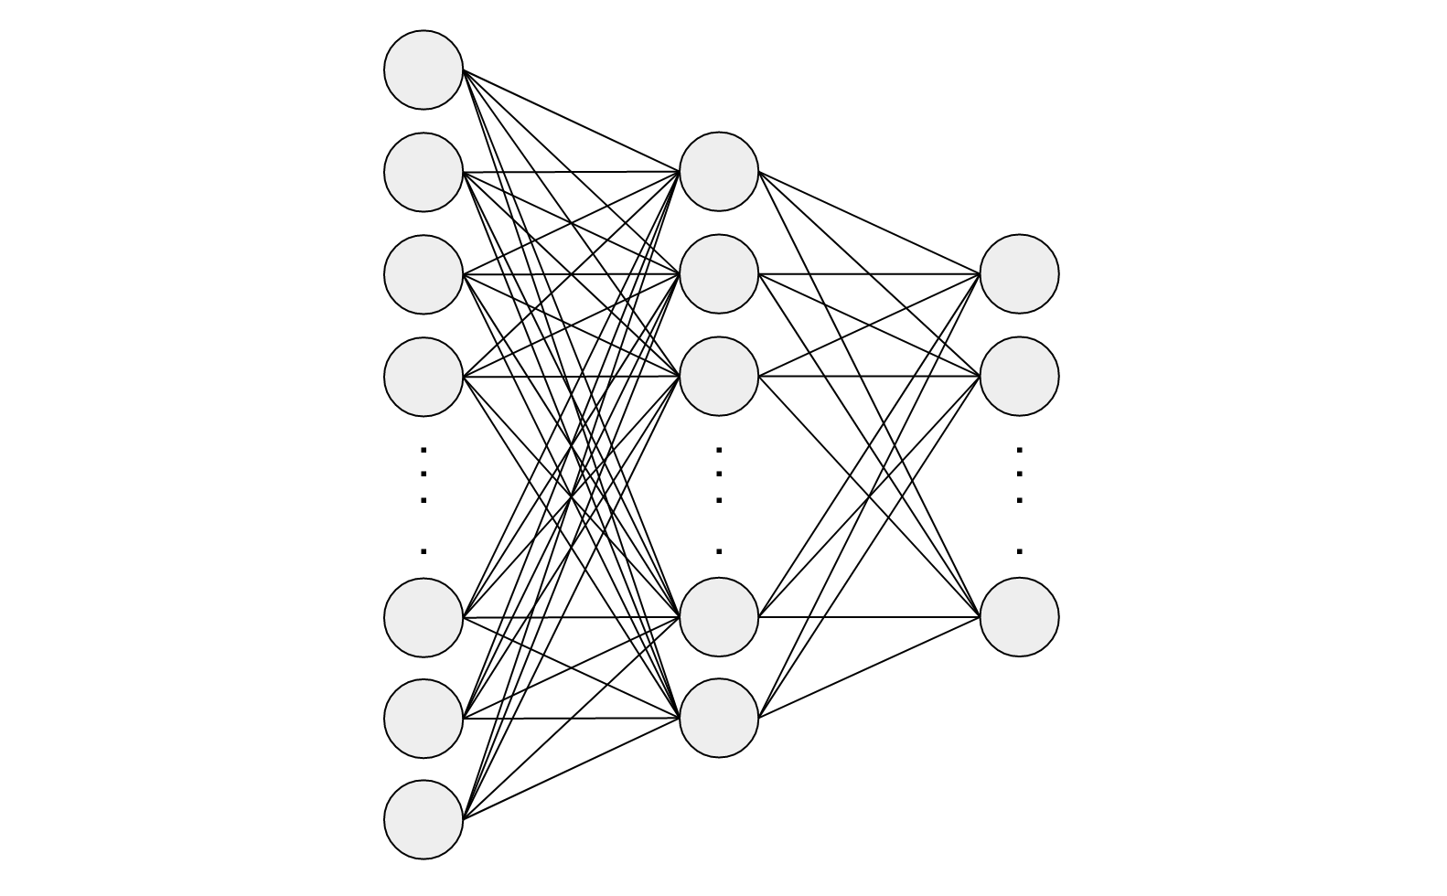
Two fully connected layers are used. It passes a flattened version of the feature maps to the first fully connected layer. Hence it has to be of dimension 64 x 7 x 7 which is equal to 3136 nodes.
Now are nodes in stead of pixels.

Slide 32
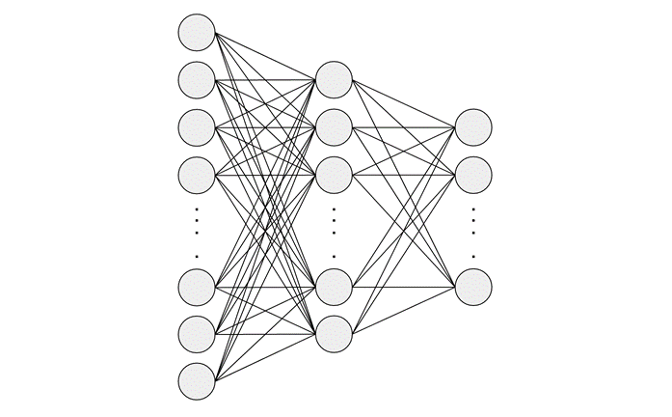
This layer(3136 nodes) will connect to another fully connected layer with 128 nodes.
This (128 nodes)will be our final layer so the output dimension should match the total classes which is 10. So we have two fully connected layers of size 3136 x 128 followed up by 128 x 10.

Slide 33

In a fully connected layer the input layer nodes are connected to every node in the second layer. We use one or more fully connected layers at the end of a CNN.
Adding a fully-connected layer helps learn non-linear combinations of the high-level features outputted by the convolutional layers.

Slide 34
Usually, activation function and dropout layer are used between two consecutive fully connected layers to introduce non-linearity and reduce over-fitting respectively.

Slide 35
At the last fully connected layer we choose the output size based on our application.
For classifying the MNIST handwritten digits the last layer will be of size 10 i.e. one node for each digit and we will take a softmax of the output which gives us a 10 dimensional vector containing probabilities (a number ranging from 0–1) for each of the digits.

Slide 36
References:
1. Francois Chollet , “Deep learning with Python”,
Manning Publications Co., 2018
2. https://towardsdatascience.com/convolution-neural-networks-a-beginners-guide-implementing-a-mnist-hand-written-digit-8aa60330d022
3. Yann LeCun, etc., “Gradient-based learning applied to document recognition”, Proceedings of the IEEE, Vol. 86, No. 11, pp.2278-2323
4.https://en.wikipedia.org/wiki/Support-vector_machine

